Slide 1
SIGNING UP and INSTALLATION of WEBEX MEETINGS Application Using DESKTOP OR LAPTOP

Slide 2
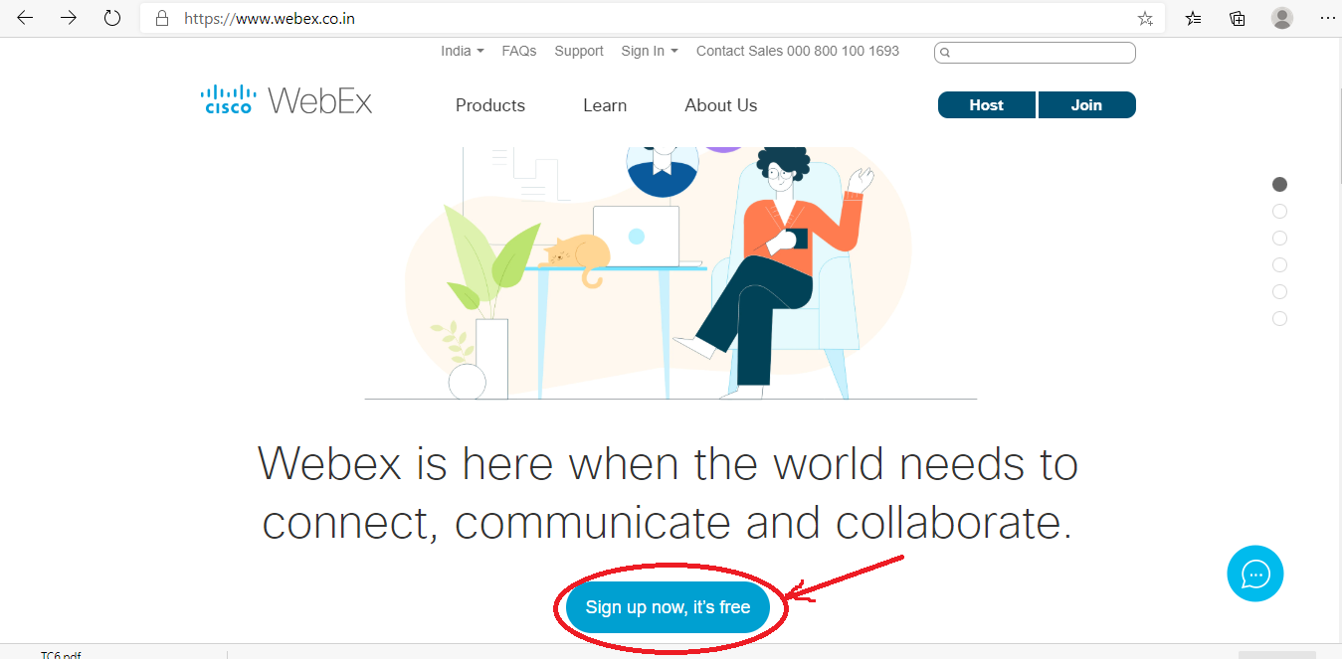
Open a Browser and type the URL” https://www.webex.co.in” and a page will open as shown above, Click at Sign up now ,its free.

Slide 3
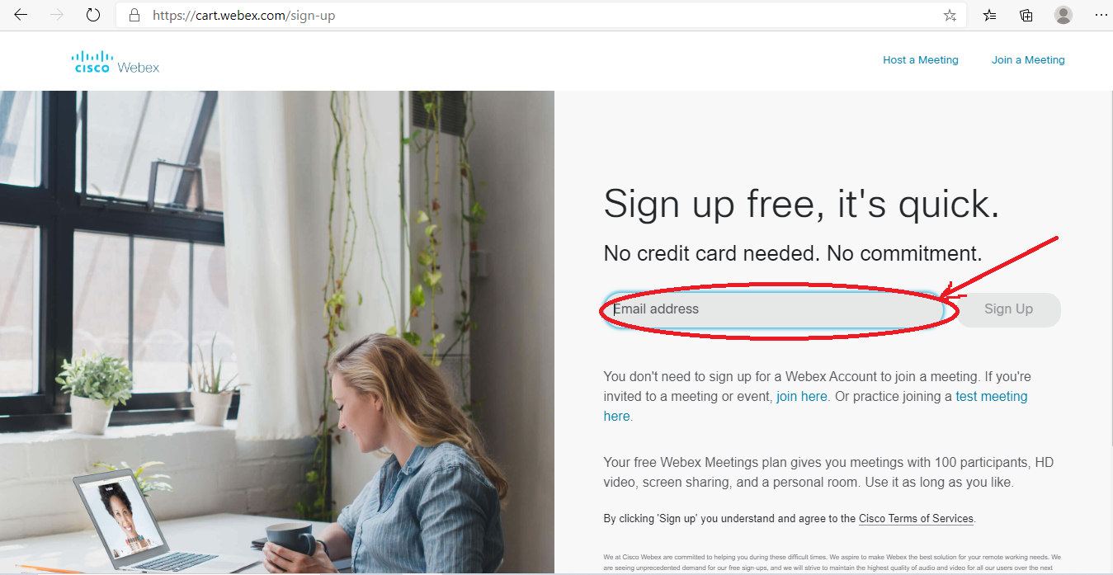
The above page will display in the email address box Type your email address and click sign up button

Slide 4
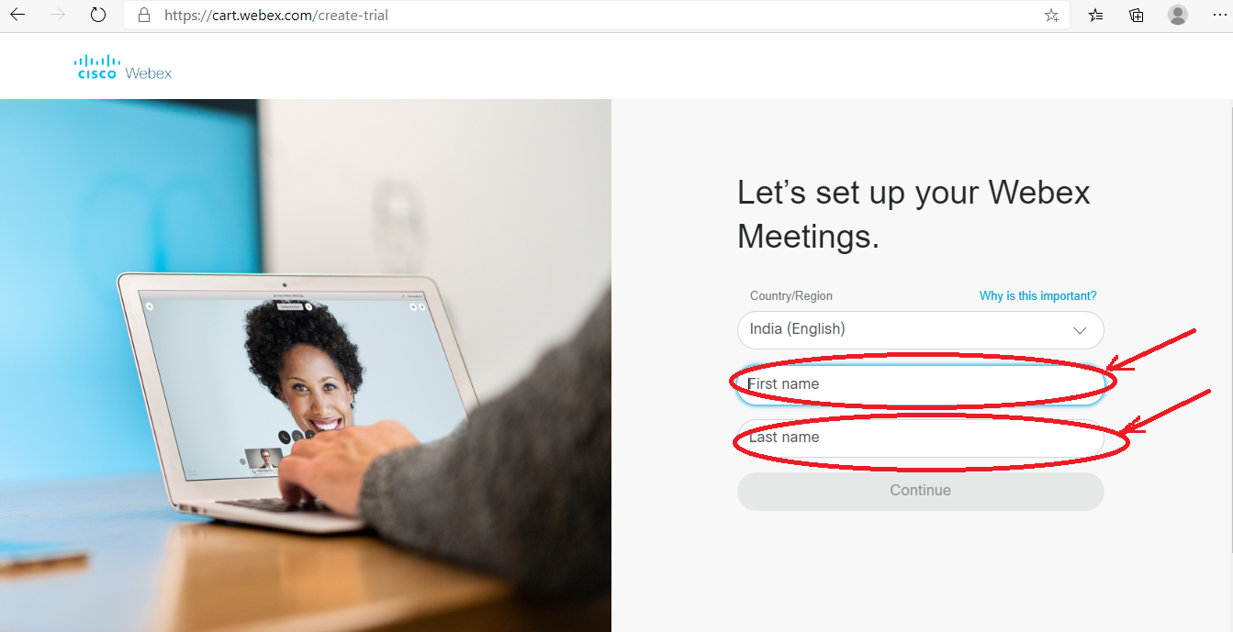
The above page will display , Suppose your name is “Sivakant Pratap” Type your First name :SIVAKANT and Last name: PRATAP and click continue button given below.

Slide 5
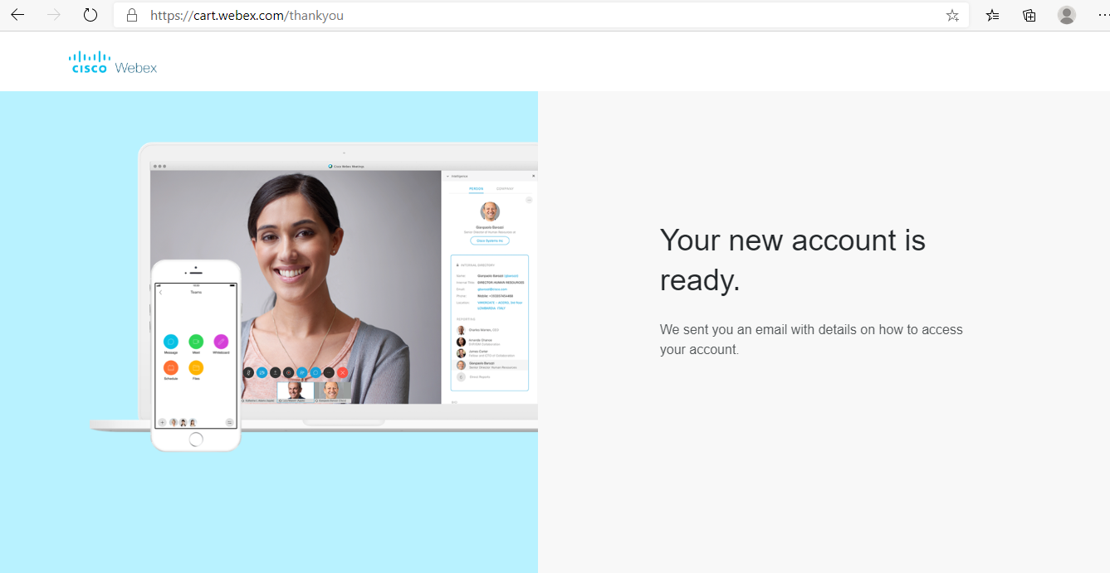
The above page will display and link for registration will receive to your registered mail. Know open your mail and open the webex link at inbox.

Slide 6
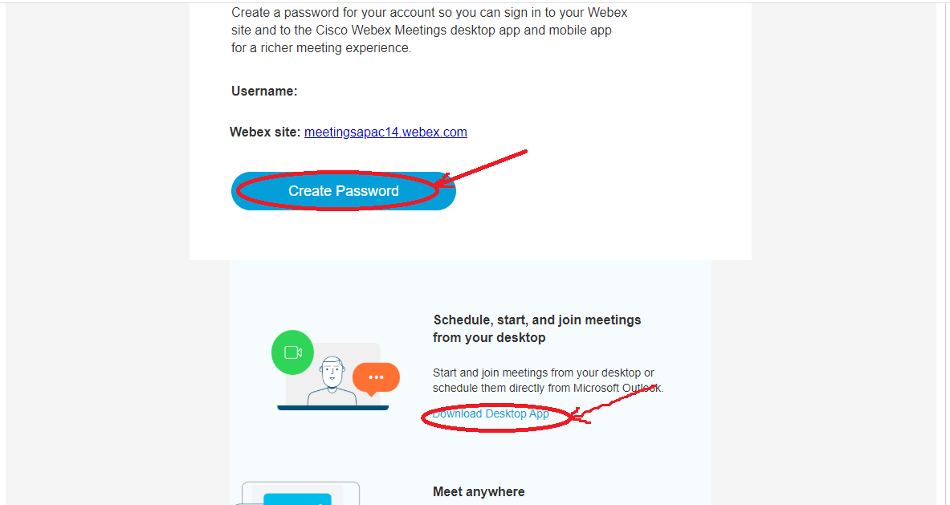
Open your mail and Click the “Create password” to create login password to cisco webex meetings.

Slide 7
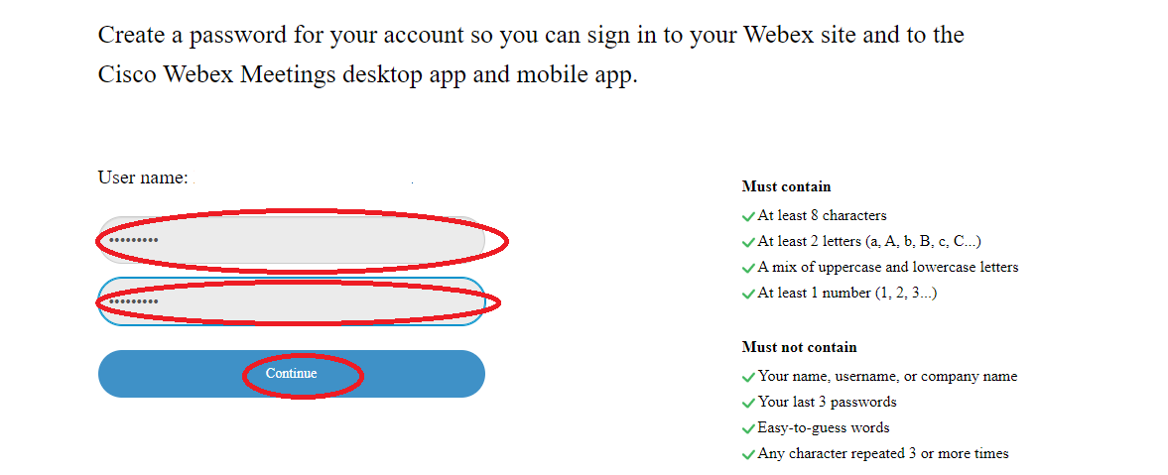
Type the password and confirm password to suit the password policy and click continue button. With this your registration process will complete.

Slide 8
Installing Webex Desktop App

Slide 9
Click the “Download Desktop App” on the same page ever you created the password on the link sent to your mail.

Slide 10
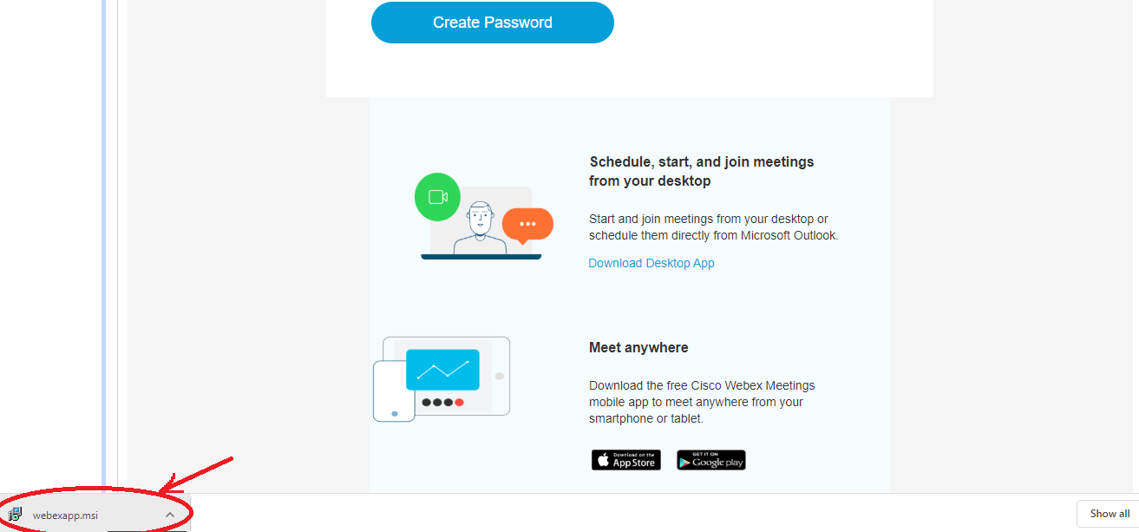
Webex Desktop application Software will get down loaded into your System, install the application into your system.

Slide 11
Webex Desktop application Icon will be created on your desktop. Click to open the app.

Slide 12
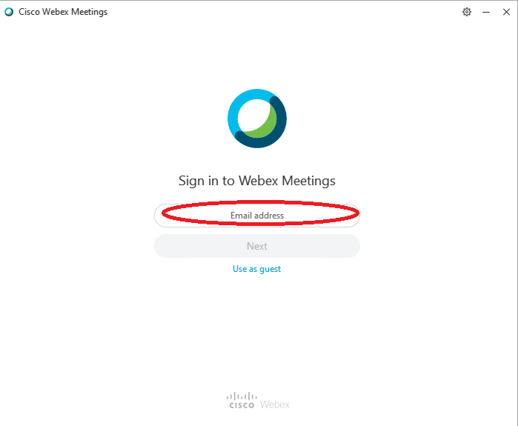
Webex Desktop application will open type your registered email at the Email address and click next

Slide 13
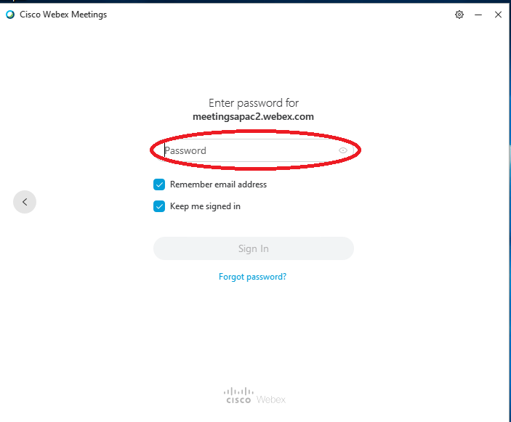
Type your registered password to Webex application.

Slide 14
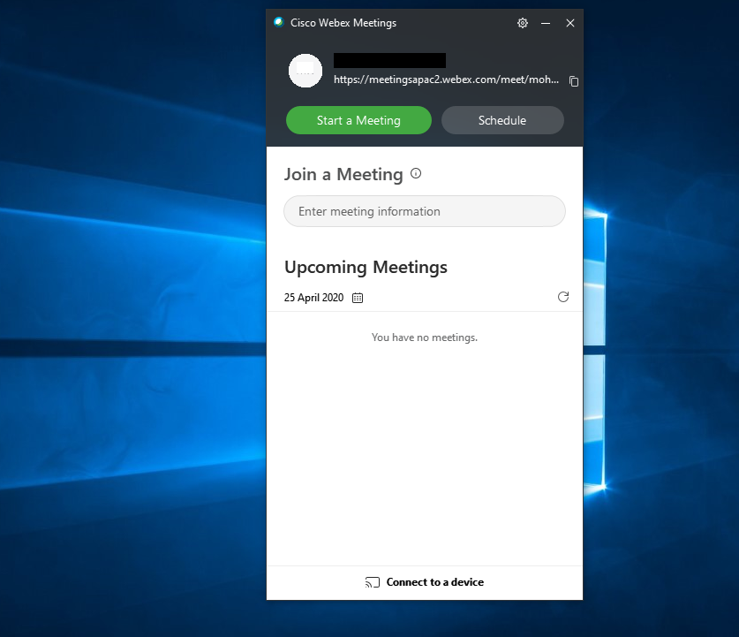
Know your are ready for joining the meeting.

Slide 15
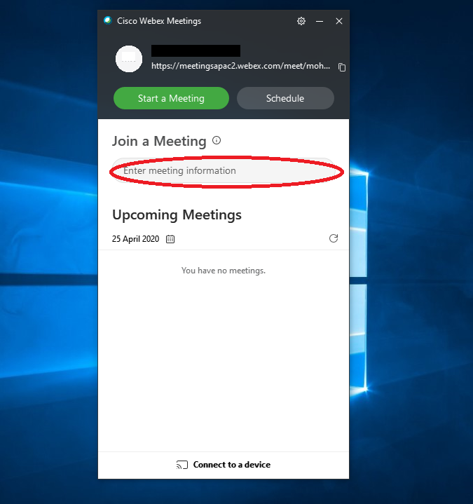
Enter the given meeting ID on the above and click enter. Know you will be in the meeting room.

